Slide 1



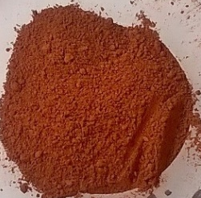
6th International Slag Valorisation Symposium
Beneficiation of iron-rich tailings from the mining industry: Case of red mud
Abdoulaye Maihatchi
LRGP
François Lapicque (DR)
Marie-Noëlle Pons (DR)
EXTRACTHIVE
Frédéric Goettmann
Quentin Ricoux
01-05 April 2019
Mechelen, Belgium

Slide 2
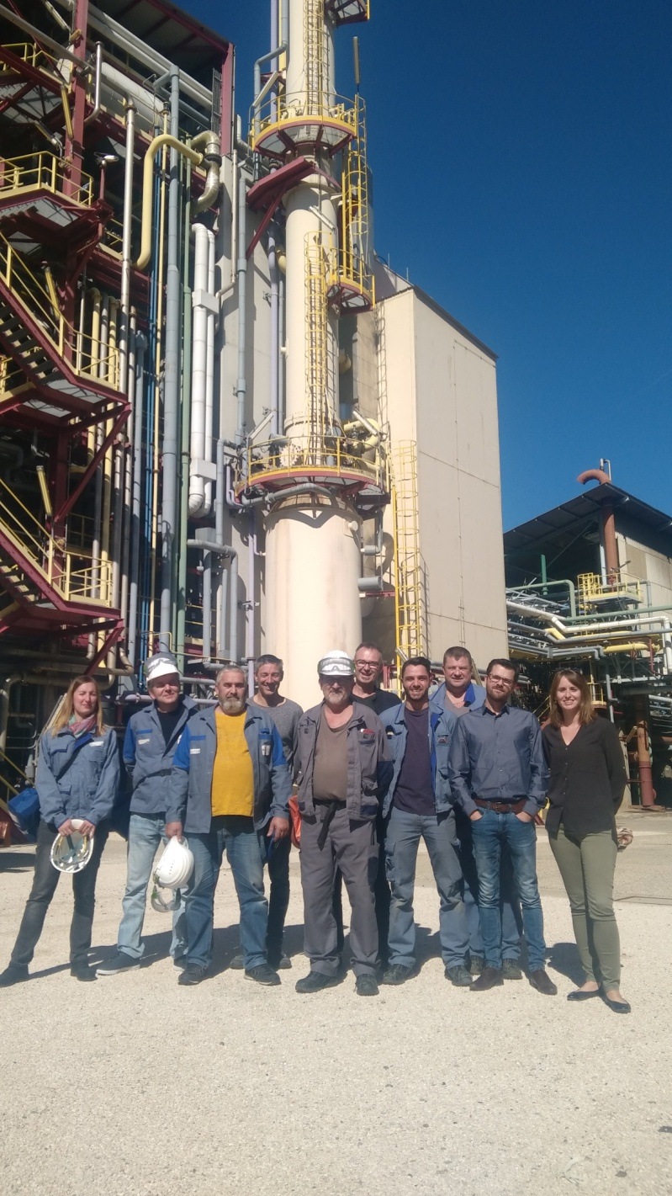



About Extracthive
Extracthive is a French company specialized in the recycling of industrial waste:
3 locations
40 employees
3.5 M€ in revenue (2018)
Extracthive Process Designer:
Our RDI team
Extracthive Ceramics Recycling:
Our comminution facility
Extracthive Chemical Products:
Our chemical plant

Slide 3




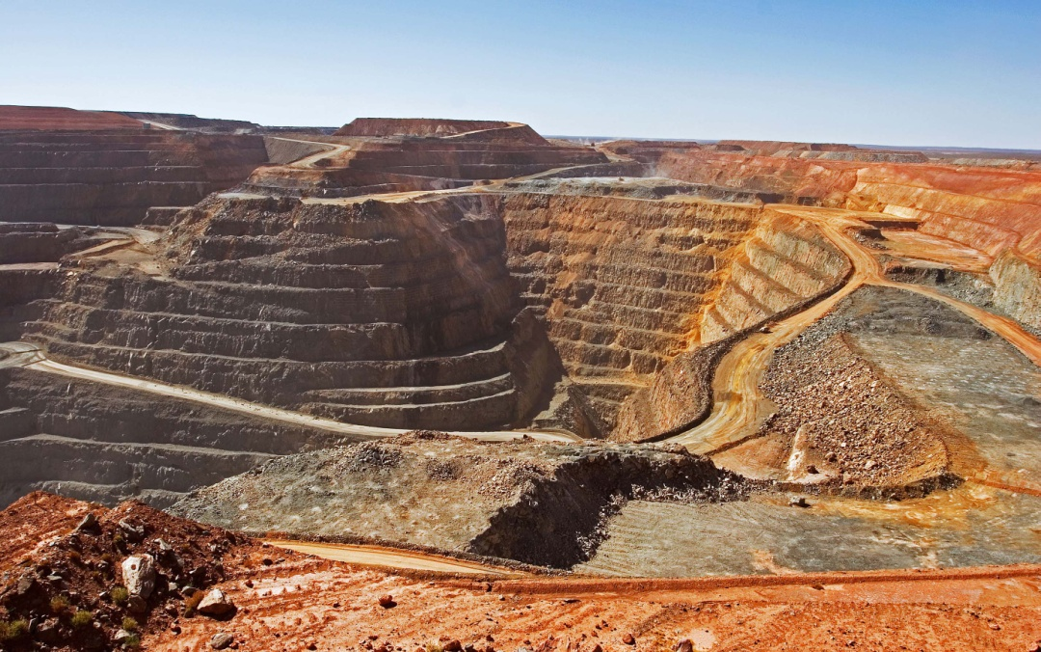
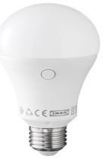

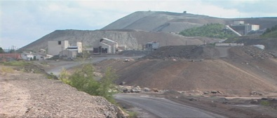
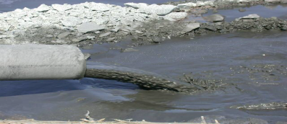
From mining to metal…and residues
Metals
Residues
→ Need to develop new processes for metals recovery from mining tailings

Slide 4
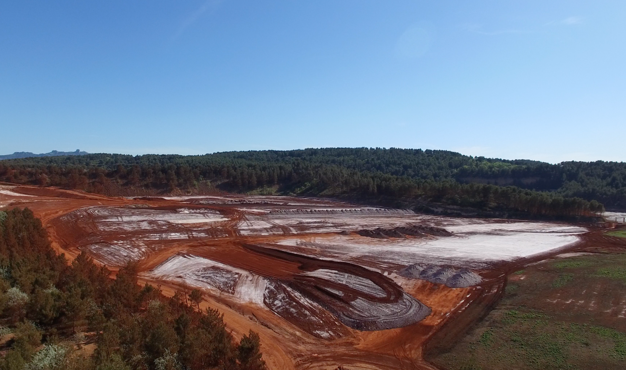
Bayer process: alumina and red mud
Bauxite
Alkaline leaching
S/L separation
S/L separation
60 %wt. Al₂O₃
20 %wt. Fe₂O₃
Washing
S/L separation
Hydrated
alumina
NaOH
Red mud
70Mt
per year [1]
Red mud
[1] Harekrushna Sutar et al., « Progress of Red Mud Utilization: An Overview », American Chemical Science Journal, p. 255‑279, 2014.

Slide 5
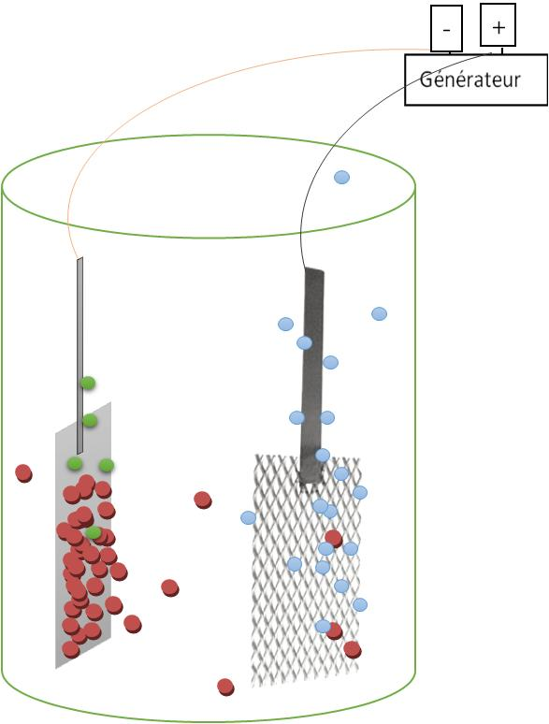
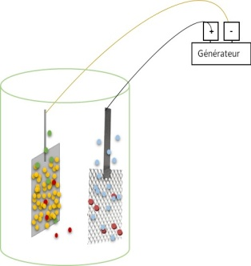
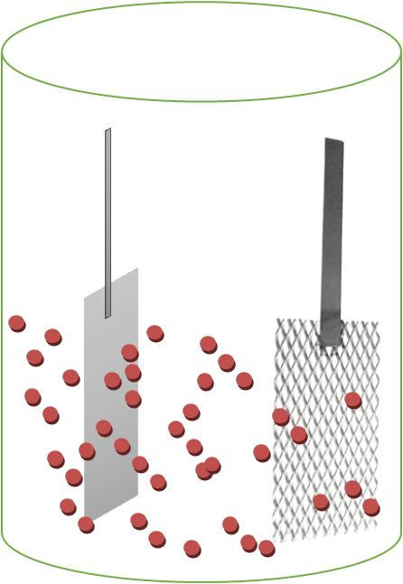
Objectifs and mechanism
Reduction of waste volume,
Production of electrolytic iron, thus creating added value,
Access to other metals contained in the residues e.g. titanium.
Mechanism of electrolytic iron production
Cathode
Anode
Fe₂O₃
Fe
O₂
2 Fe₂O₃ + 6H₂O + 12 e⁻ → 4 Fe + 12 OH⁻

Slide 6



Our philosophy
Bauxite
Alkaline leaching
S/L separation
S/L separation
Red Mud
Mixing
NaOH
Electrowinning
110°C
Electrolytic iron
Electrolytic iron
Water
+NaOH
S/L separation
Solid residue
Solid residue
→ Three samples
To compare the faradaic yields and the quality of electrolytic iron, the electrowinning is carried out on the commercial hematite and the red muds

Slide 7
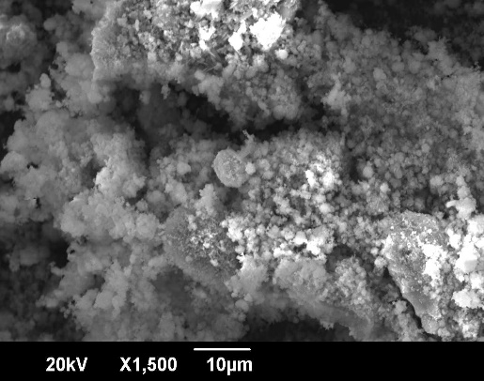
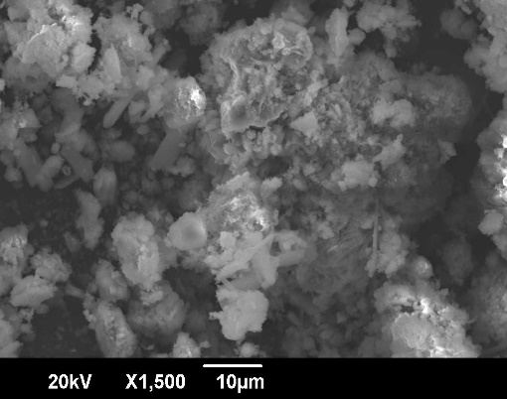
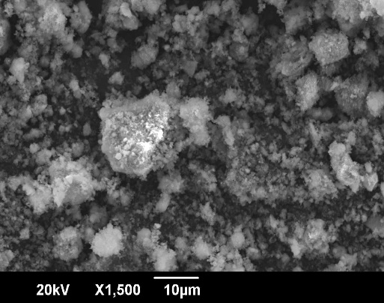
Chemical and morphological analysis
Chemical composition (FR RM)
 | Fe₂O₃ | Al₂O₃ | SiO₂ | TiO₂ | CaO | Na₂O | Ins.
Wt%. | 52.3 | 10.2 | 0.19 | 3.28 | 2.83 | 2.41 | 10
CA RM
Size distribution…
SK RM
FR RM

Slide 8
Mineralogical composition
The composition varies according to the origin of the red mud
Hematite is the main common phase in the three red muds
Due to the amorphous structure of the red mud, it's difficult to identify minor phases

Slide 9
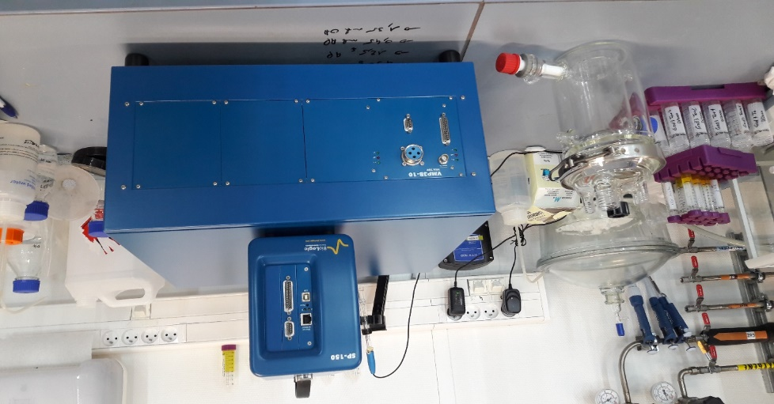
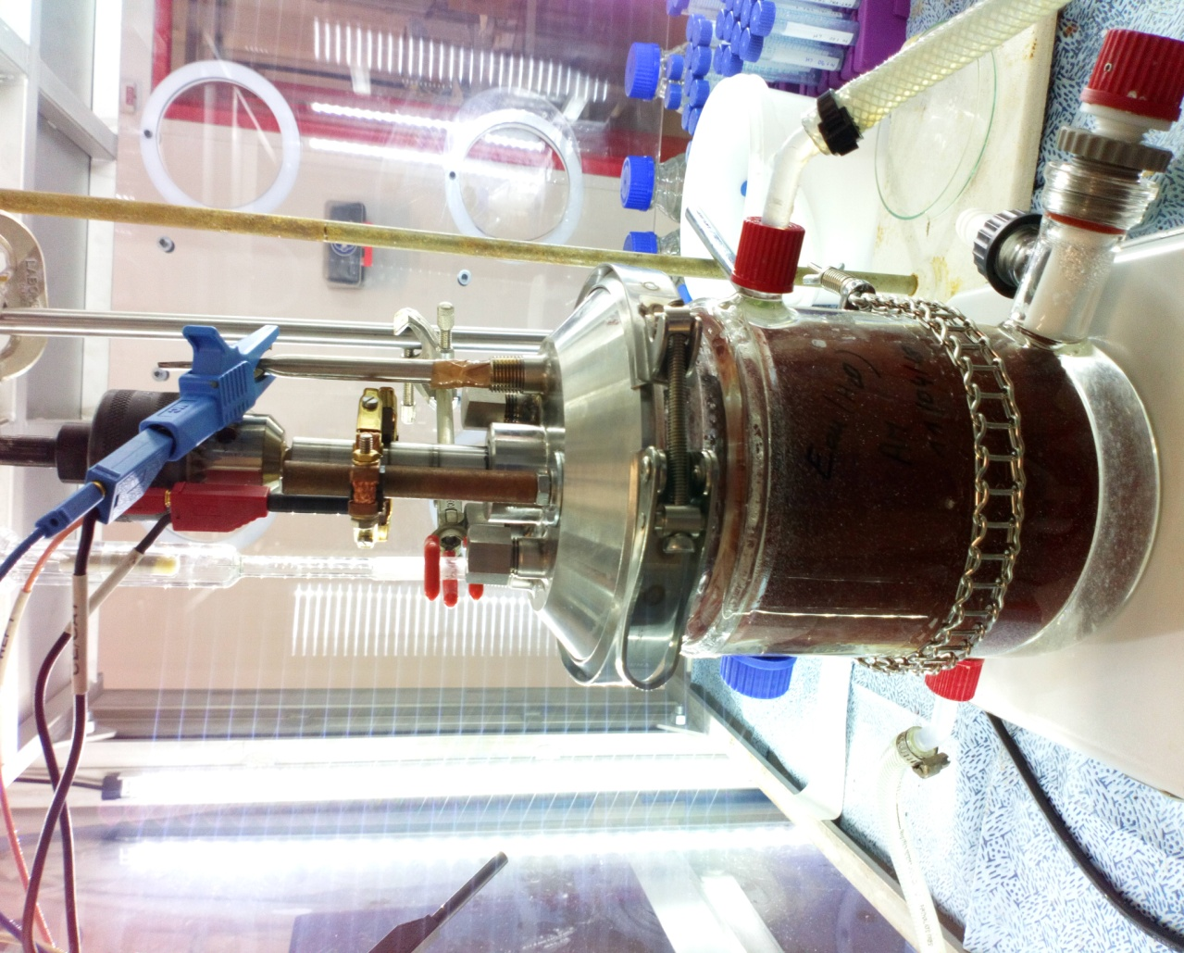
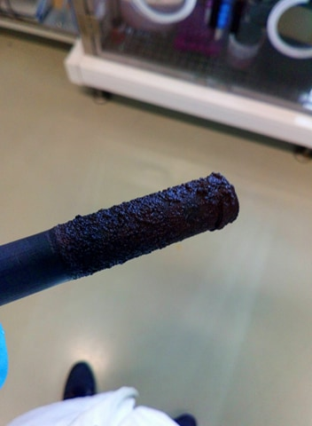
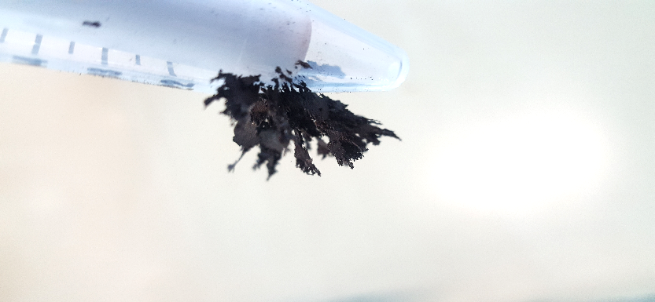
Experimental device
Reference
electrode
Ag/AgCl
Cathode
in graphite
Anode
in platinum -titanium
Potentiostate
Electrolysis cell
Oil circulation
(T=110 °C)
Cathode + iron
Approximately 450 mL of 12.5 M NaOH solution and 150 g of red mud were used for each experiment.
A potentiostate SP-150 of 800 mA coupled to a booster 10 A was used as the current source (chronopotentiometry)

Slide 10
Electrodeposition of iron
→ Cyclic voltammetry
S = 19,4 cm²
40 mV/s
→ Faradaic yields
The tests were carried out under
the same conditions (temperature,% Fe₂O₃)
For each red mud, the current density is chosen based on the cyclic voltammetry curves.

Slide 11
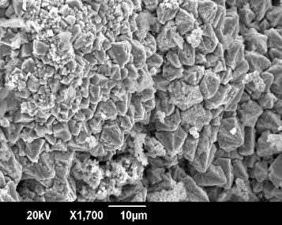
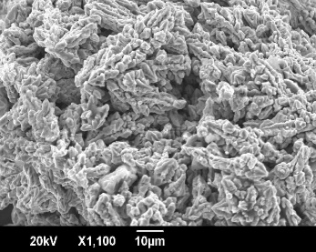

Quality of deposit iron …
Chemical
composition
 | % Fe | % Na | % Al
Fe- hematite | 99,6 | 0,125 | 0,250
Fe – CA RM | 96,5 | 0,189 | 0,192
Fe – FR RM | 97,3 | 0,222 | 0,134
Fe – SK | 88,3 | 1,25 | 0,417
Fe- FR RM
Mineralogy and morphology
* graphite peak
Fe-hematite
In the case of SK RM, the 88% Fe is explained by the fact that it was difficult to scrape the cathode because of the small amount of the deposit: therefore the mass used to determine the chemical composition contained a certain amount of carbon from the cathode.

Slide 12

To conclude…
→ Our objective was to study the feasibility of production of iron from red mud.
Red mud analysis has shown that it contains about 50% wt. hematite.
Faradaic yields: 85 % hematite, 50 % FR RM,
42 % CA RM and 33 % SK RM.
Purity of electrolytic iron: 99.6 % hematite, 96.5 % CA-RM, 97.3% FR RM and 88.3 % for SK RM.
Prospect
Find another way to reduce the effect of impurities (using inhibitors for example),
Or eliminate these impurities by pretreatment of the red mud before electrodeposition.

Slide 13

Thank you for
your attention
http://lrgp-nancy.cnrs.fr/
www.extracthive.com

